Slide 1
TRAVEL IN TAINAN
5/30(五)~6/2(日)

Slide 2
Directory
Itinerary planning
Transportation
SPENDING

Slide 3

Itinerary planning

Slide 4
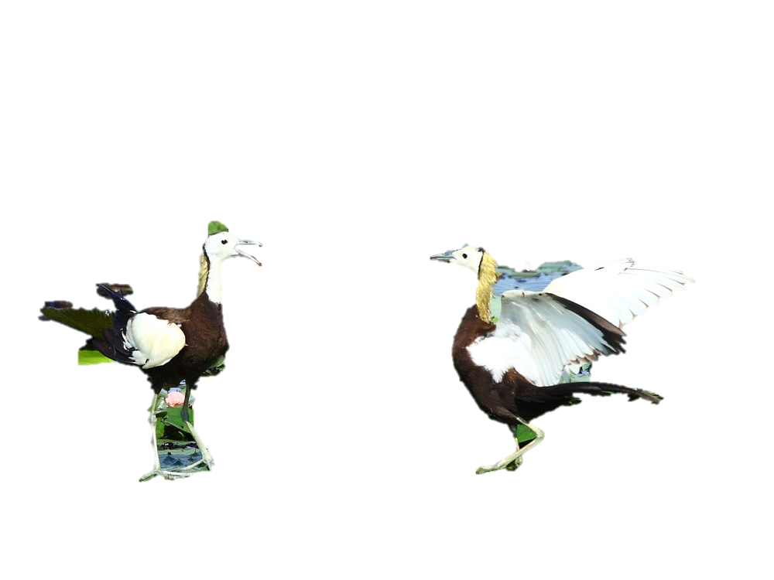
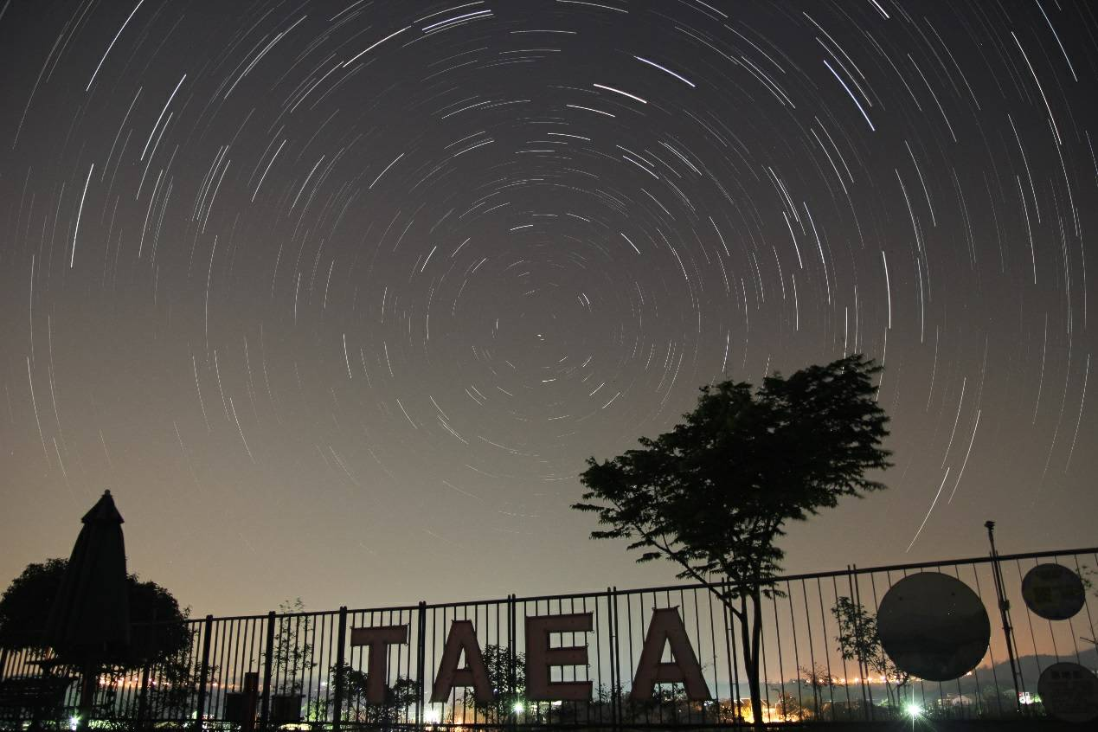
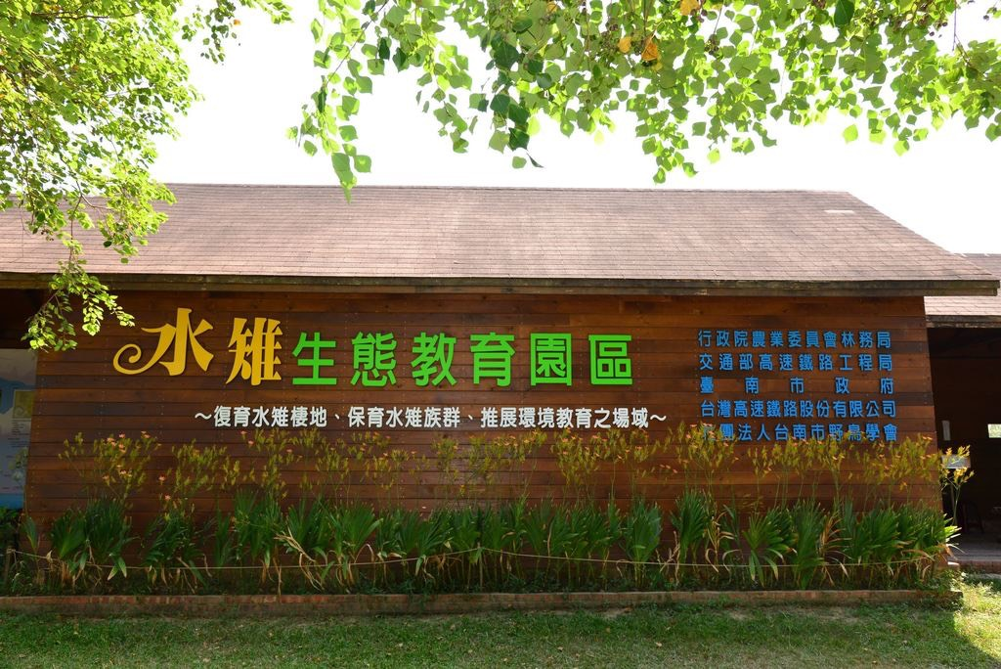
DAY 1
8:00 GO TO TAINAN~
10:00~12:00
Minamata Ecological Education Park
14:00~1700
Tainan Astronomical Education Area
The park is not only rich in aquatic plants, but also has many waterfowl ecology. The most important bird ecology is the Lingbo Fairy-Water Marsh that is symbiotic with the Lingjiaotian.
Provide a place for outdoor education and science education in schools

Slide 5
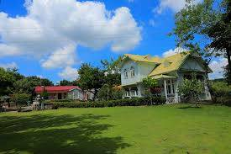
Chenxi Mountain Villa Leisure Homestay

Slide 6
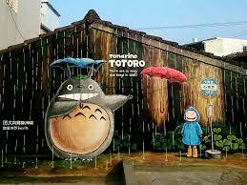
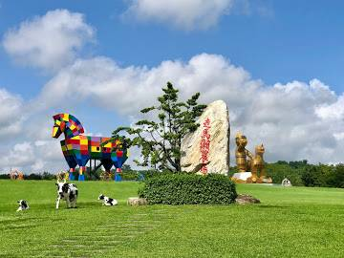
DAY 2
11:00~14:00
Ouchi Totoro Bus Station
14:00~
TSOU MA LAI FARM
This Farm is surrounded on three sides by the Zengwun River’s middle and lower reaches, and encircled by Wushan Ridge of the Alishan Mountains, forming a paradisical natural habitat.
The Totoro Bus Station is a small painted village. The painting of old houses adds color to the community.

Slide 7
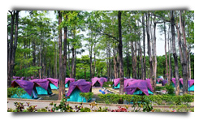
TSOU MA LAI FARM
Item |  | Two-day (including one-day) plan | Three-day plan | Four-day plan | Five-day plan
8-person tent |  | NT 300 dollars | NT 450 dollars | NT 600 dollars | NT 750 dollars
Sleeping bag |  | NT 50 dollars | NT 80 dollars | NT 110 dollars | NT 140 dollars
Blanket |  | NT 50 dollars | NT 80 dollars | NT 110 dollars | NT 140 dollars
Cooking gears |  | NT 250 dollars | NT 350 dollars | NT 450 dollars | NT 550 dollars
Portable cooker |  | NT 40 dollars | NT 60 dollars | NT 80 dollars | NT 100 dollars
Table |  | NT 100 dollars | NT 200 dollars | NT 300 dollars | NT 400 dollars
Campsite fee (per unit) |  | NT 450 dollars | NT 900 dollars | NT 1350 dollars | NT 1800 dollars
Chair |  | NT 10 dollars | NT 20 dollars | NT 30 dollars | NT 40 dollars
Food waste |  | NT 30 dollars | NT 40 dollars | NT 50 dollars | NT 60 dollars
Paintball field fee |  | Fixed target shooting: NT 20 dollars per person; paintball game: NT 50 dollars per person (must be reserved beforehand)
Campfire field fee |  | NT 1,000 dollars per day (not including firewood, fuel, and other materials)
Barbecue site |  | NT 100 dollars per unit if used at night
Industry Plaza | Weekends and holidays | NT 3,000 dollars for 4 hours (NT 3,500 dollars during nighttime)
 | Weekdays | NT 2,000 dollars for 4 hours (NT 3,500 dollars during nighttime)

Slide 8
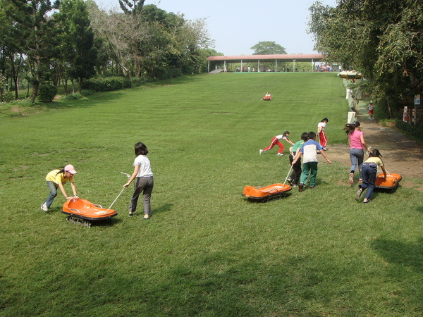
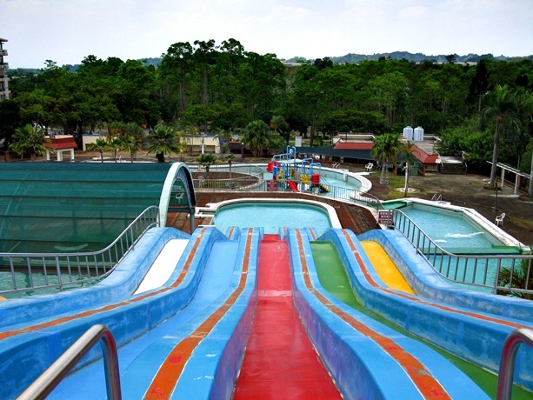
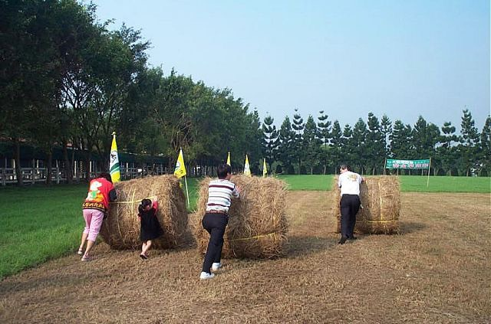
DAY 3
Tsou-Ma-Lai Farm is a multi-function, full-accommodation travel destination, a paradise for all seasons ideal for individual or group itineraries, one-night or an extended stay, and one-stop or multi-stop. Its reputation is on the rise domestically and internationally and favorable comments and guests are increasing every day. It offers a relaxed and joyful stay for all occasions, whether conference, training, or group leisure activities.
1

Slide 9
Transportation

Slide 10
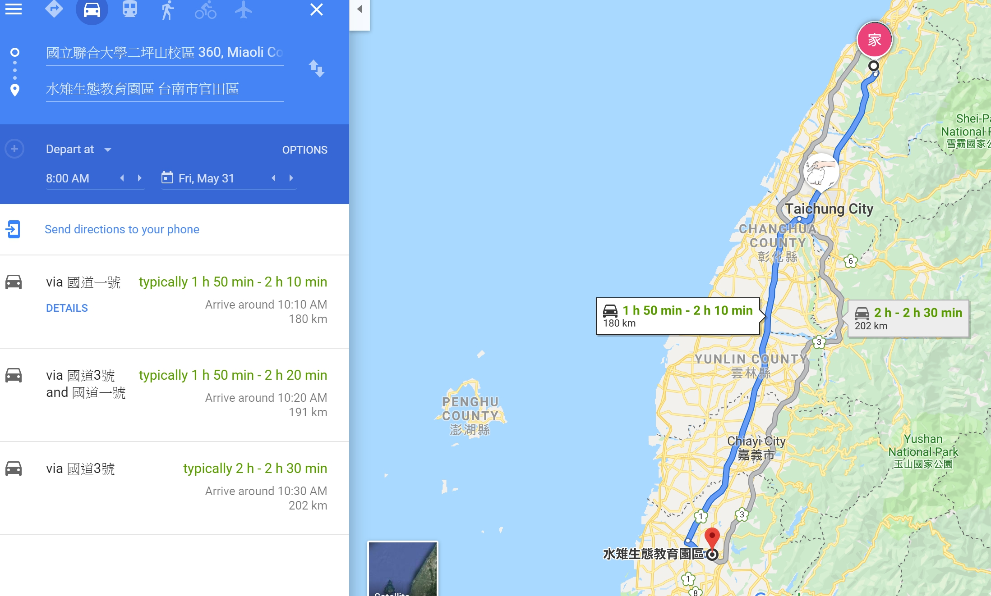
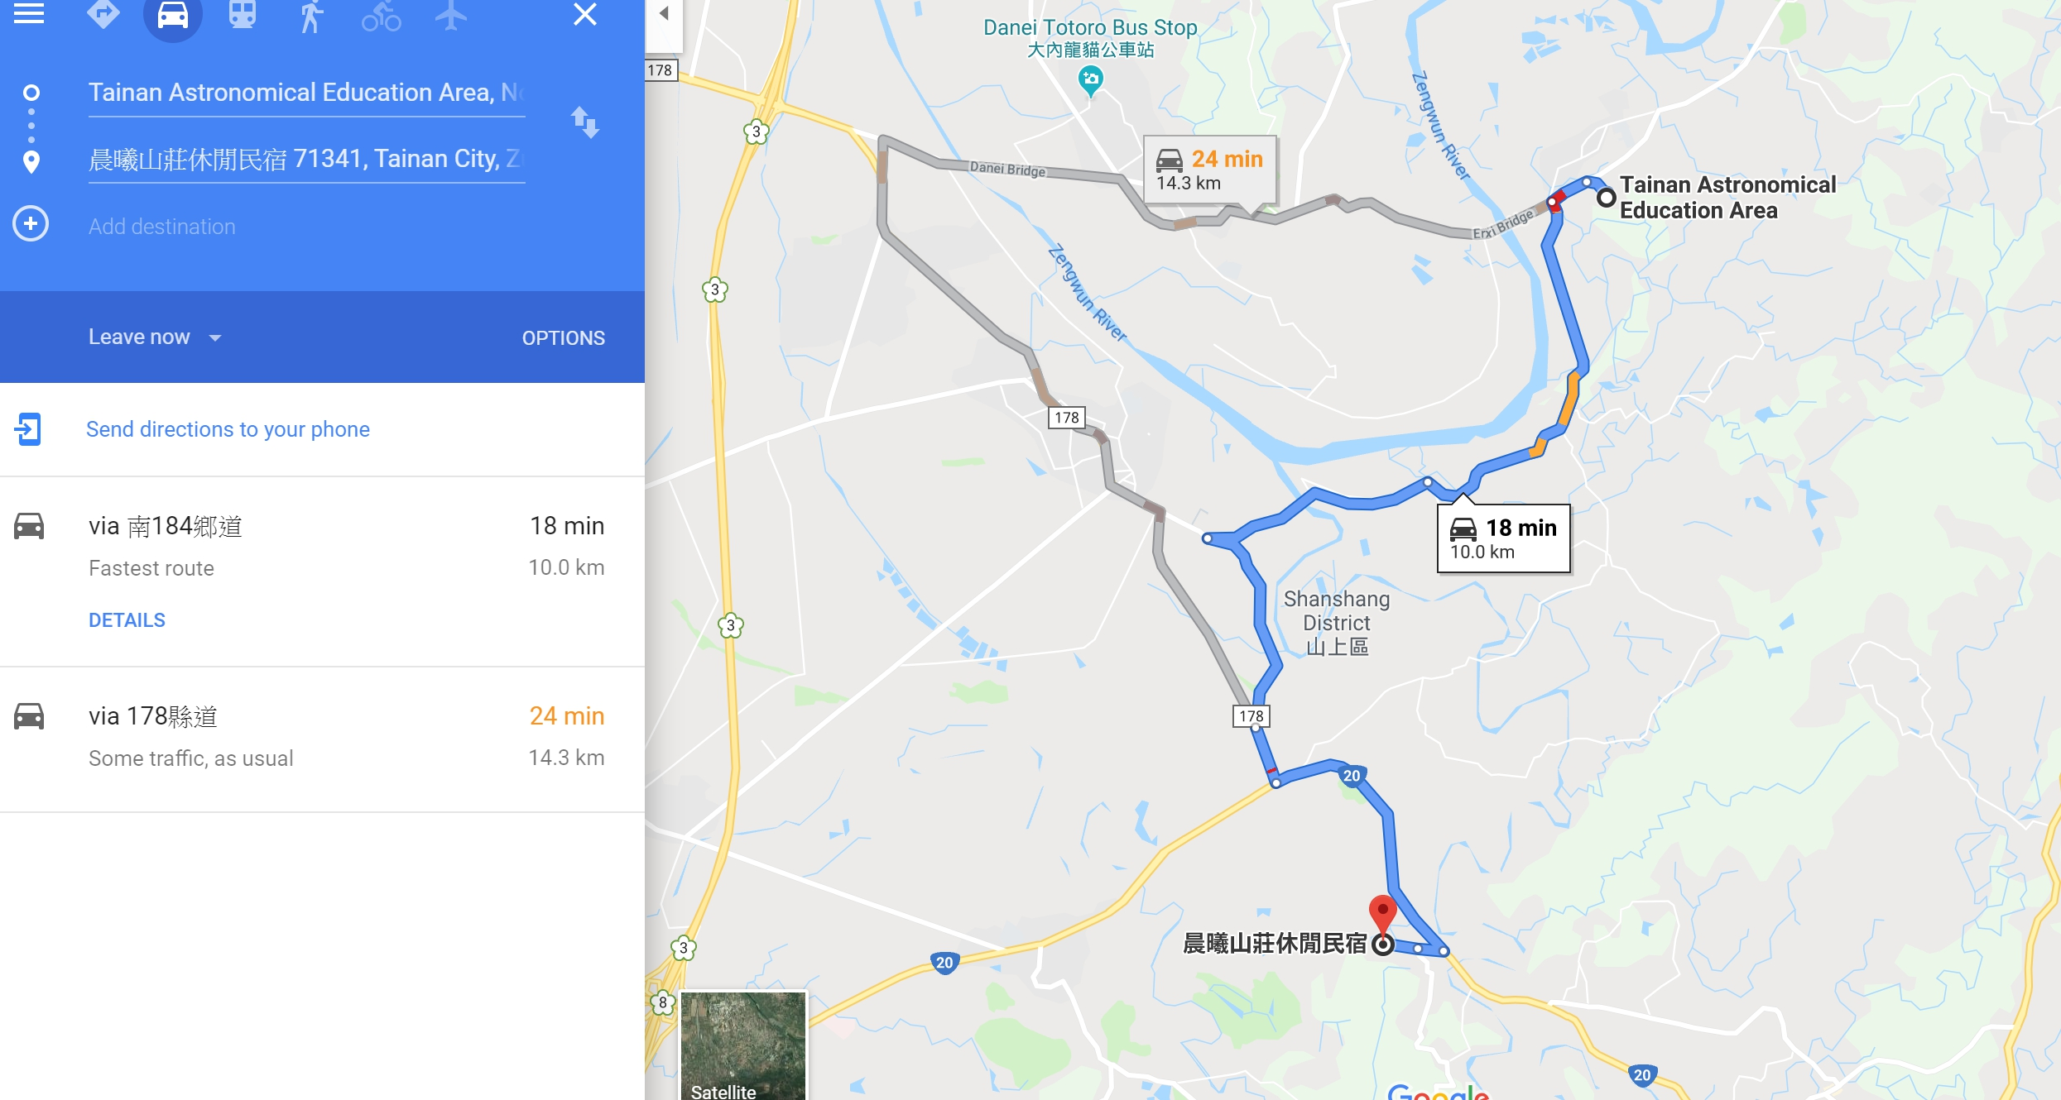
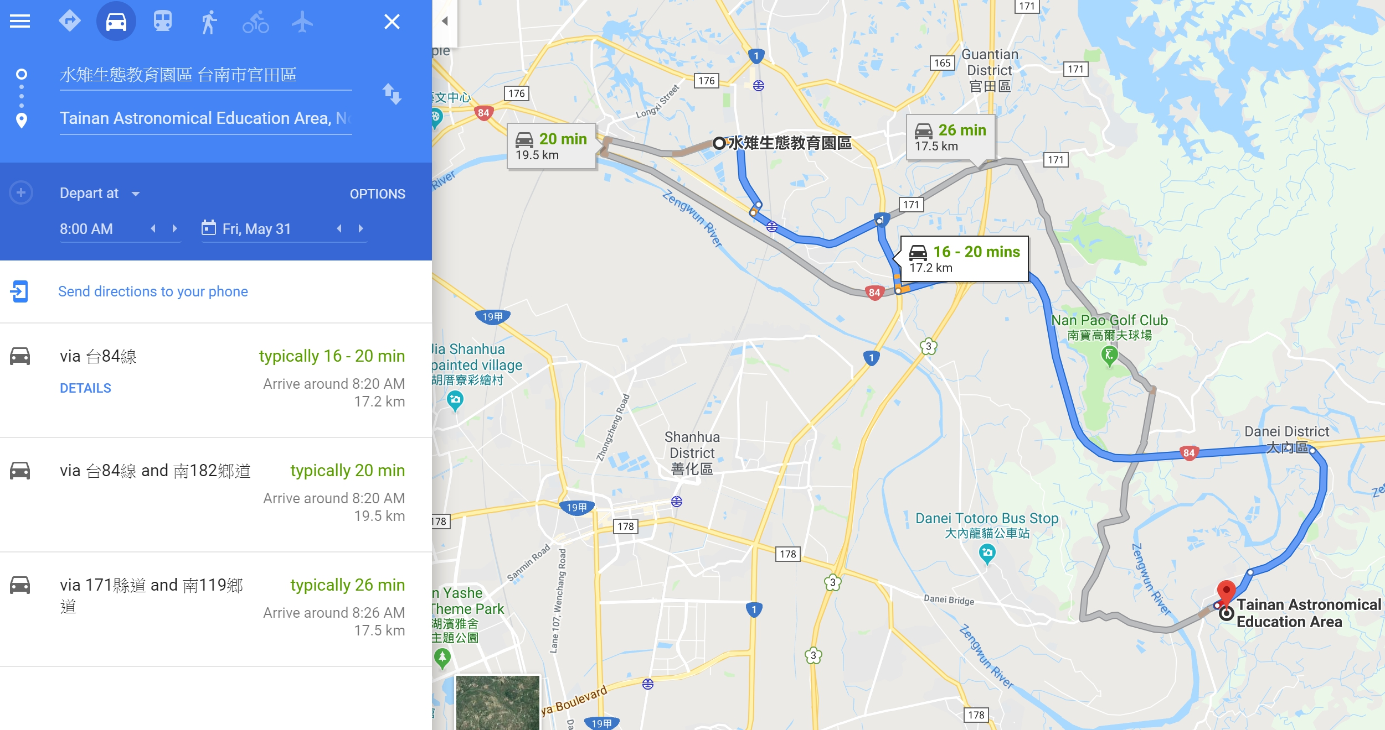
DAY 1

Slide 11
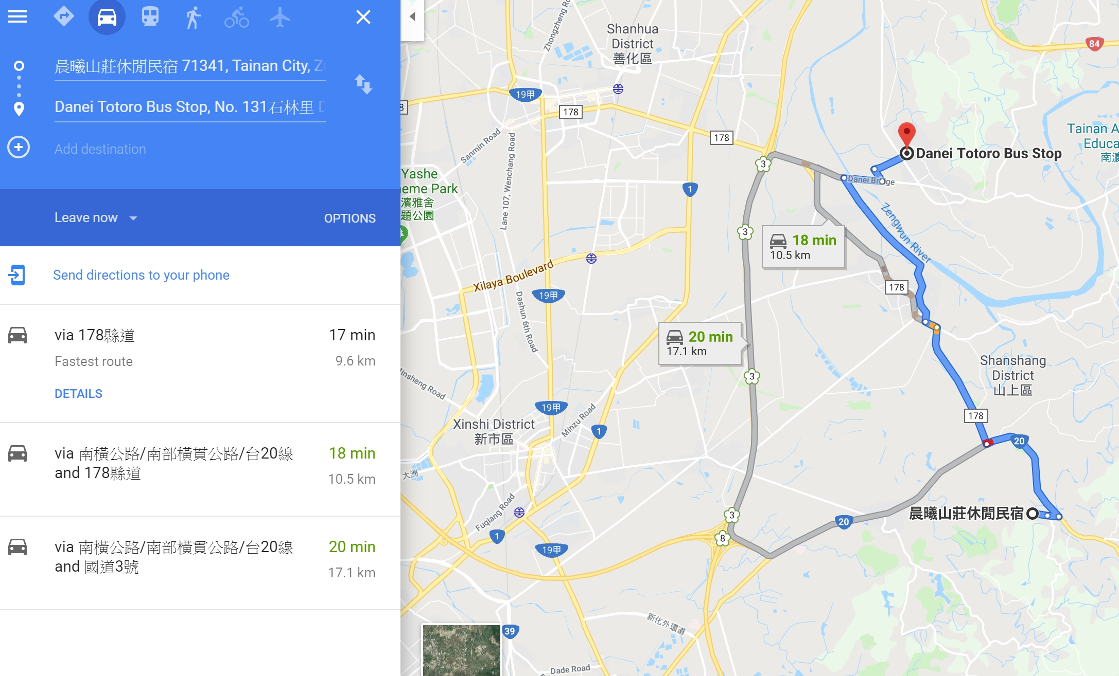
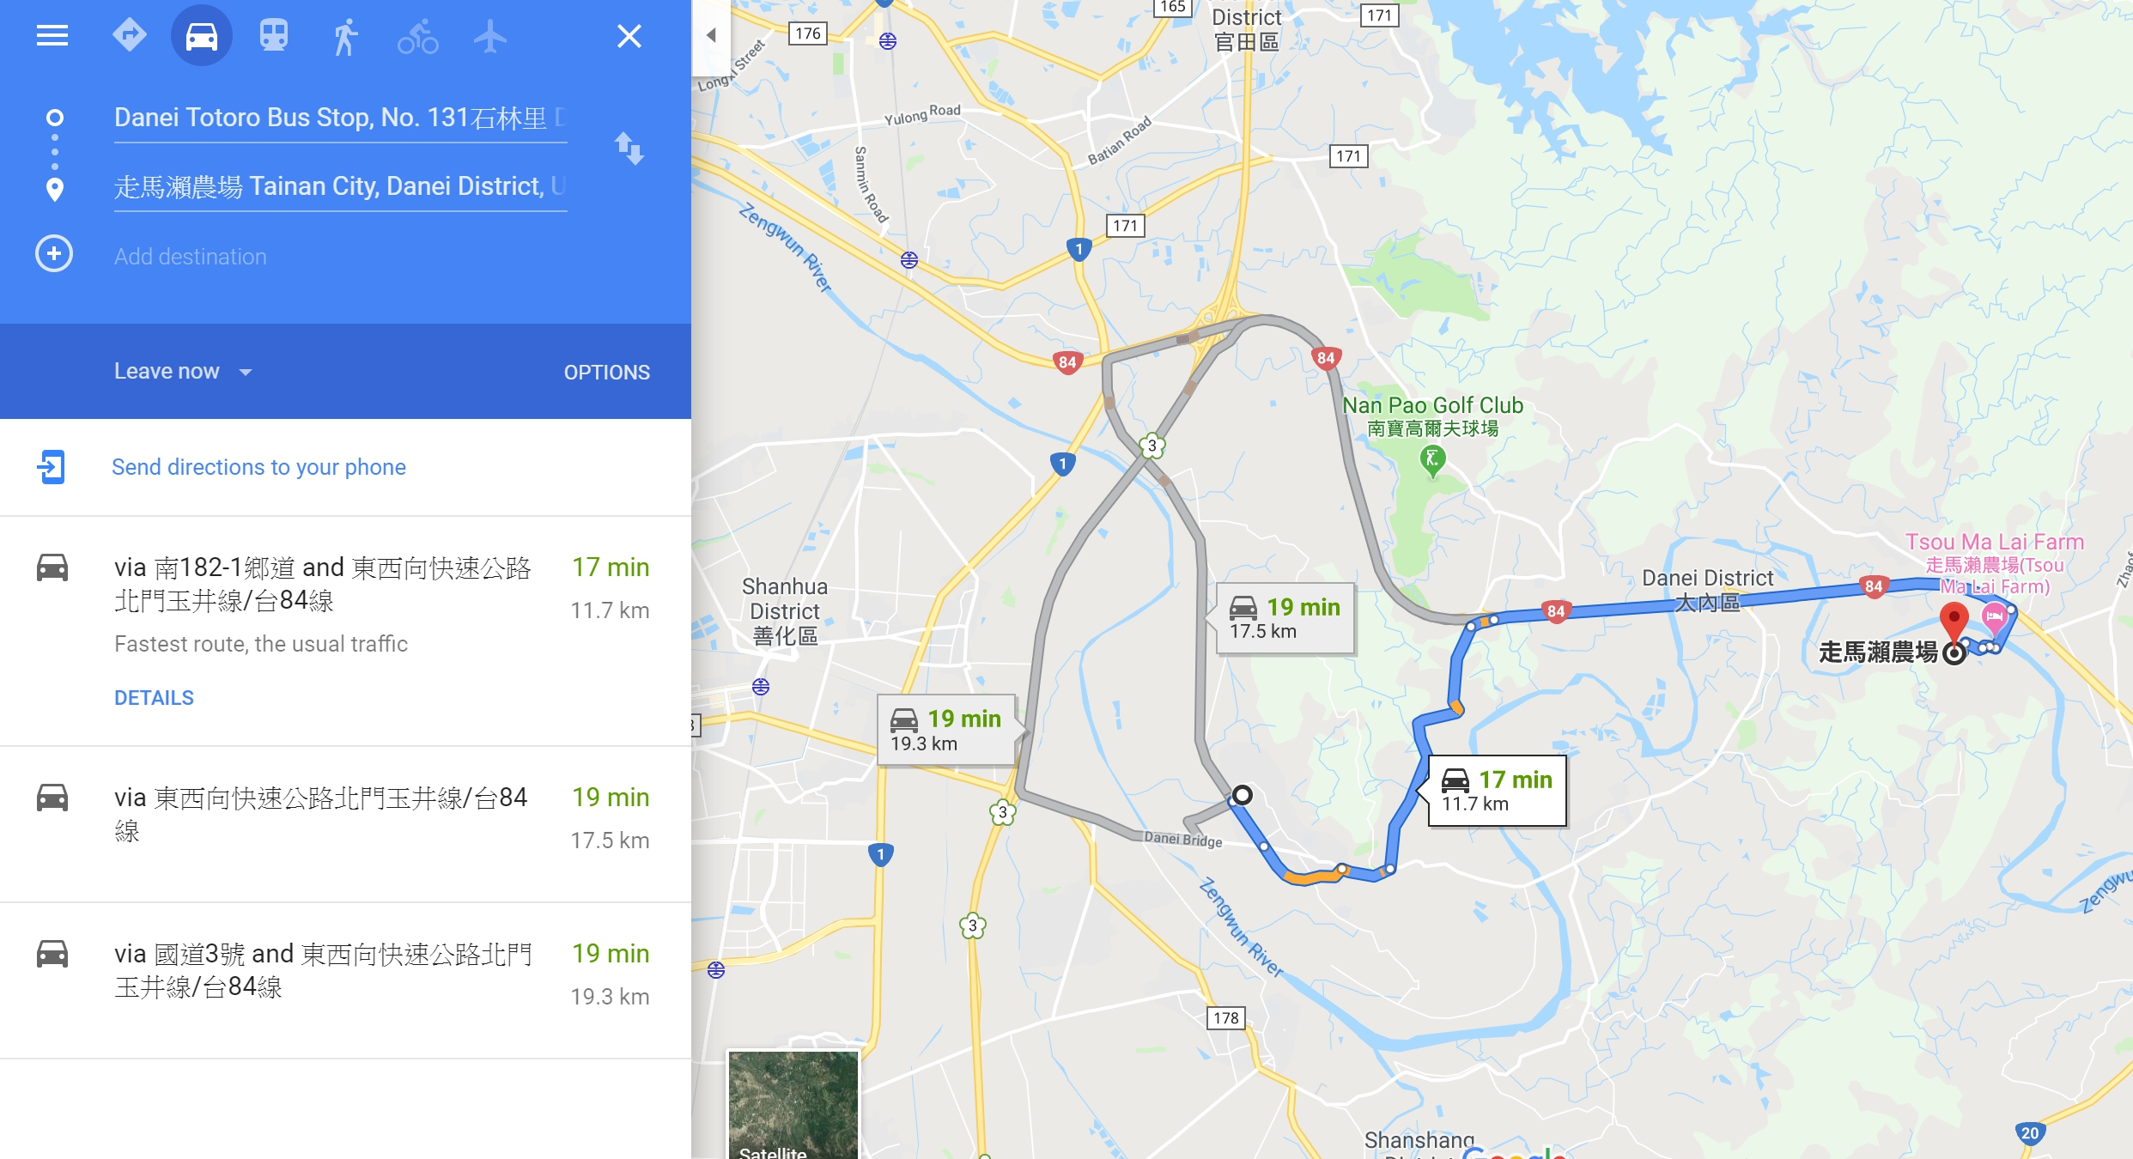
DAY 2

Slide 12
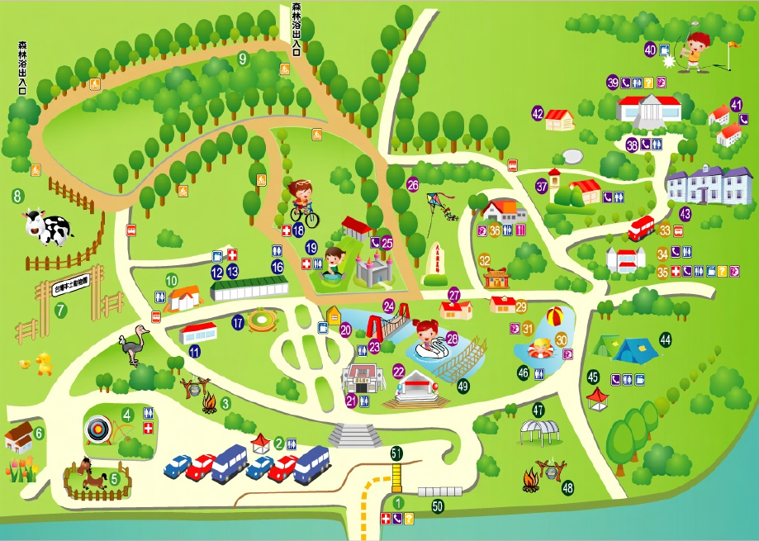
DAY 3

Slide 13
SPENDING

Slide 14




TICKET NT＄250/ PERSON
OIL NT＄2000/ 4 PERSON
HOTEL NT＄2600+ ＄ 480/4 PERSON
FOOD NT＄750/ PERSON
SOUVENIRS NT＄1500/ PERSON
TOTAL :
NT ＄3770 /PERSON

Slide 15
TRAVEL IN TAINAN
THANKYOU FOR LISTENING

